Slide 1
CHAPTER 5 - COUNTING

Slide 2
Choose a 6-character password: ******
* can be 0..9, a..z, A..Z
How many possible passwords ?
How many passwords begin with a or A?
How many passwords begin with a or end with A?

Slide 3
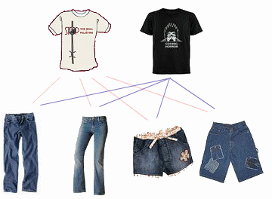
Product rule
Task = task 1 AND task 2
2
×
4
Task 1: choose one
Task 2: choose one

Slide 4
Product rule
THE PRODUCT RULE
Task = task1 ➔ task 2 ➔ task 3 ➔ … ➔ task k
task 1: n1 ways
task 2: n2 ways
…
Task k: nk ways
----------------------------
Product rule: n1.n2…nk ways to do the task

Slide 5
Product rule
Example. A new company with just two employees, No and Mon, rents a ﬂoor of a building with 12 ofﬁces. How many ways are there to assign different ofﬁces to these two employees?
➔ 2 task2: 12. 11
Example. How many different bit strings of length seven are there?
➔ 7 tasks: 2.2.2.2.2.2.2 =2⁷

Slide 6
How many functions are there from {a, b, c} to {1, 2, 3, 4, 5} ? How many one-to-one functions?
function
Input
Output
A •
B •
C •
• 1
• 2
• 3
• 4
• 5

Slide 7
Exercises
1/ If there are 5 multiple-choice questions on an exam, each having four possible answers, how many different sequences of answers are there?
2/ In how many ways can a teacher seat 5 girls and 3 boys in a row seats if a boy must be seated in the first and a girl in the last seat?

Slide 8
Exercises
A = {1, 2, 3, 4, 5, 6}
a. How many subsets of A can be constructed?
b. How many subsets of A that contain 1?
c. How many subsets neither contain 3 nor 4?

Slide 9
The principle of Inclusion-exclusion
|A∪B| = |A| + |B| - |A∩B|
• a
• f
A
• b
• d
B
• e
• c
| A∪B | = |A| + |B| - |A∩B| = 4 + 3 - 1

Slide 10
The principle of Inclusion-exclusion
How many bit strings of length eight either start with a 1 bit or end with the two bits 00?
Result = 2⁷ + 2⁶ - 2⁵
1*******
1*****00
******00
2⁷ ways
2⁶ ways
2⁵ ways

Slide 11
Advanced counting techniques

Slide 12
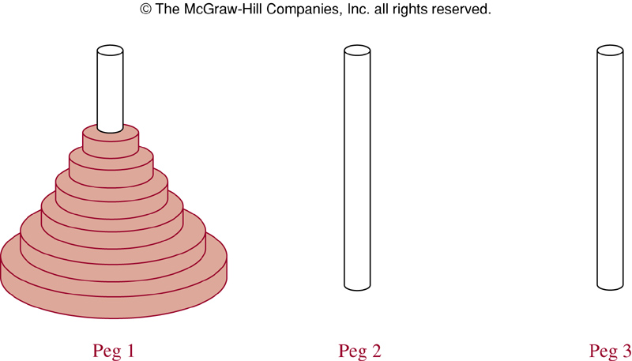
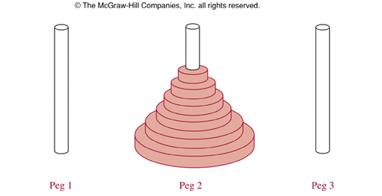
The Tower of Hanoi Problem- Ex5, page 452
How many steps this problem is solved if there is n disks on the peg 1?
Notes:
A popular puzzle of the late nineteenth century invented by the French mathematician Edouard Lucas, called the Tower of Hanoi.
Three pegs mounted on a board together with disks of different sizes. Initially these disks are placed on the first peg in order of size, with the largest on the bottom.
Rules: Disks to be moved one at a time from one peg to another as long as a disk is never placed on top of a smaller disk.
Goal: all the disks on the second peg in order of size, with the largest on the bottom.
Question: How many moves needed to solve the Tower of Hanoi problem with n disks?

Slide 13
Tower of Hanoi – 3 disks
Peg1
Peg2
Peg3
3 disks → 7 steps

Slide 14
Tower of Hanoi problem
n = 1 disk ⇒ H₁ = 1 step
n = 2 disks:
Peg1 → Peg3
Peg1 → Peg2
Peg2 ← Peg3
⇒ H₂ = 3 steps
n = 3 disks ⇒ H₃ = 7 steps
n disks ⇒ H_{n} = ? // number of steps for n disks

Slide 15
Tower of Hanoi problem - How many steps for n = 4 and more?
Peg1
Peg2
Peg3
3 disks: H₃ = 7 steps
1 disk: 1 step
3 disks: H₃ = 7 steps
Number of steps for 4 disks:
H₄ = 2H₃ + 1 = 15

Slide 16
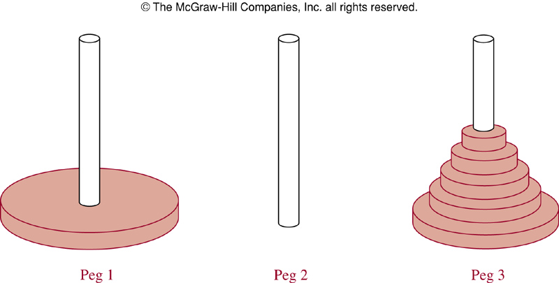
Tower of Hanoi problem with n disks
H_{n}= 2H_{n-1} + 1 // recurrence relation
H₁ = 1 // initial condition
⇒ H_{n} = 2^{n} – 1, n  1 // solution
n = 64 → H₆₄ = 2⁶⁴-1
(=18 446 744 073 709 551 615)
1 move/sec → more than 500 billion years.
Complexity O(2^{n})

Slide 17
How many bit strings of length n that not have two consecutive 0s
n : length of bit string
a_{n}: number of such bit strings of length n
n | all 2^{n} bit strings of length n | a_{n}
1 | 0, 1 | a₁ = 2
2 | 00, 01, 10, 11 | a₂ = 3
3 | 000, 001, 010, 011, 100, 101, 110, 111 | a₃ = 5
4 | 0000, 0001, 0010, 0011, 0100, 0101, 0110, 0111, 1000, 1001, 1010, 1011, 1100, 1101, 1110, 1111 | a₄ = 8
… | … | …
n | a_{n-2}: number of such strings begin with 0 (in fact, 01) a_{n-1}: number of such strings begin with 1 | a_{n} = a_{n-2} + a_{n-1} (Fibonacci)
Notes:
Begin with 0: 0000, 0001, 0010, 0011, 0100, 0101, 0110, 0111,
Begin with 1: 1000, 1001, 1010, 1011, 1100, 1101, 1110, 1111

Slide 18
Recurrence Relations
Recurrence relation:
H_{n} = 2H_{n-1} + 1
a_{n} = a_{n-1} + a_{n-2}
Initial conditions:
H₁=1
a₁=2, a₂=3
Notes:
Some of the counting problems that cannot be solved by using basic principle rules can be solved by finding relationships, called recurrence relations, between the terms of a sequence.
In example 1, a₀=3, a₁= 5 are the initial conditions (a₀, a₁ are terms that precede a₂, which is the first item where the recurrence takes effect).
The recurrence relation and initial conditions uniquely determine a sequence. A recurrence relation, together with initial conditions, provide a recursive definition of the sequence.

Slide 19
Recurrence Relations
Example: Determine whether {a_{n}} = 3n is a solution of the recurrence relation
a_{n}= 2a_{n-1} – a_{n-2}, n ≥ 2?
a_{n} = 3n ⇒ a_{n-1} = 3(n-1) and a_{n-2} = 3(n-2)
The right-hand side = 2a_{n-1} – a_{n-2} = 2.3(n-1) – 3(n-2)
The right-hand side = 3n = a_{n}
Left-hand side = Right-hand side
⇒ a_{n} is a solution of the recurrence relation

Slide 20
Divide-and-Conquer Algorithms and recurrence Relations
Divide: Dividing a problem into one or more instances of the same problem of smaller size
Conquer: Using the solutions of the smaller problems to find a solution of the original problem, perhaps with some additional work.
Notes:
- Many recursive algorithms take a problem with a given input and divide it into one or more smaller problems.

Slide 21
Recurrence Relations for Binary Search
procedure bsearch(x, i, j)
if i > j
return 0
else
m= ⎣(i+j)/2⎦
if x= a_{m}
return m
else if x< a_{m}
bsearch(x, i, m-1)
else
bsearch(x, m+1, j)
need f(n)
comparisons
need f(n/2)
comparisons
f(n) = f(n/2) +2
Notes:
- In binary search, a problem of size n has been reduced to ONE problem of size n/2.

Slide 22
Recurrence Relations for Finding Maximum of a sequence
procedure findmax(i,j: integer ,a_{i},a₂₊₁,…,a_{j}: integers)
if i=j
return (a_{i})
else
m:= ⎣(i+j)/2⎦
max1:= findmax (i,m,a_{i},a_{i+1},…,a_{m})
max2:= findmax (m+1,j,a_{m+1},a_{m+2},…,a_{j})
if max1 > max2
return max1
else
return max2
need f(n)
comparisons
f(n) = 2f(n/2) +1
need f(n/2)
comparisons
need f(n/2)
comparisons
Notes:
- The problem is reduced to finding the maximum of each of two smaller sequences. A problem of size has been reduced into TWO problems of size n/2.

Slide 23

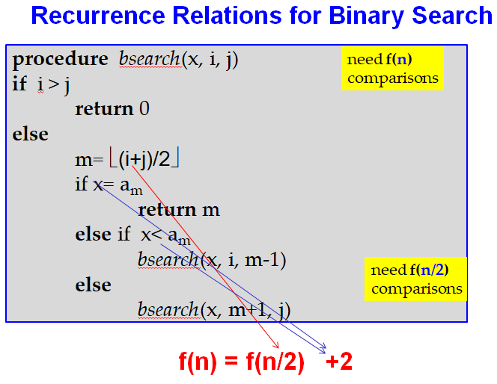
Theorem. [ … ]
f(n)= af(n/b) + c ➔
a=1
c=2
b=2
Ex.
f(n) = f(n/2) + 2
➔ f(n) is O(logn)
?
O(logn) time complexity

Slide 24
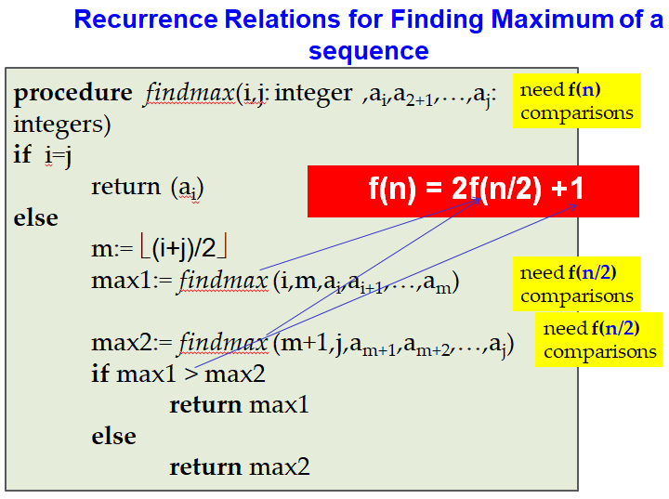
Theorem. [ … ]
f(n)= af(n/b) + c ➔
What is big-O time
complexity of the findmax algorithm?

Slide 25
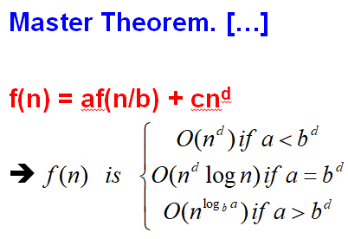
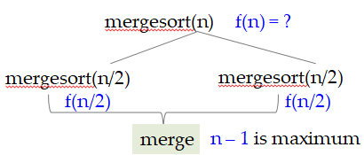
Complexity of merge sort
f(n) = 2f(n/2) + n
a = b^{d}: f(n) is O(n¹logn)

Slide 26
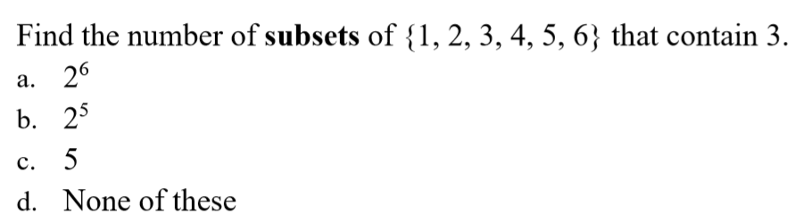
Quiz
✓

Slide 27
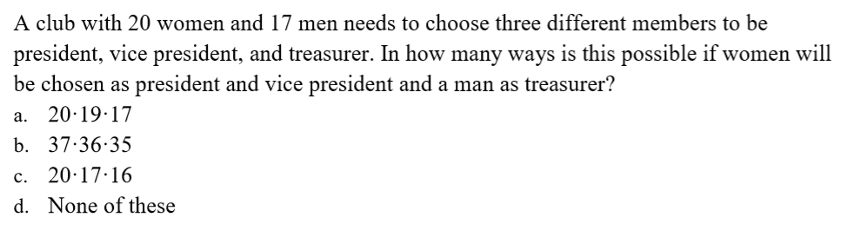
✓

Slide 28
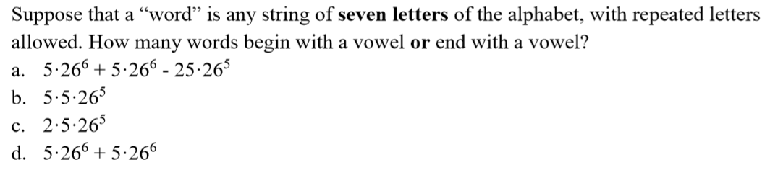
✓

Slide 29
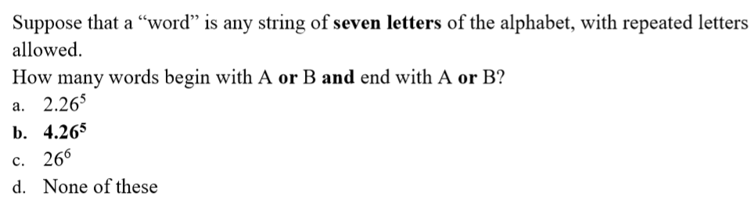
✓

Slide 30
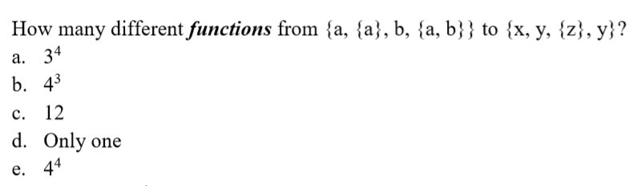
✓

Slide 31
Answer: 8
Answer: 6.2⁶⁵

Slide 32
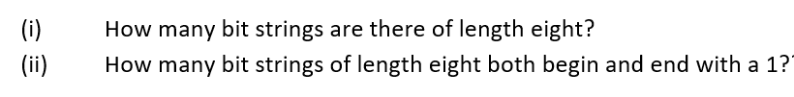
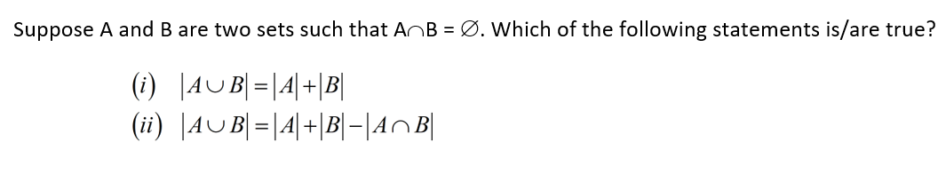
Answer: (i) 2⁸ (ii) 2⁶
Answer: both

Slide 33
A push-button door lock requires you to enter a code to open. The lock has ﬁve buttons, numbered 1, 2, 3, 4, 5. If a code consists of a sequence of four digits, with repeated numbers allowed, how many codes are possible?
Answer: 5⁴

Slide 35
THANKS

